Slide 1
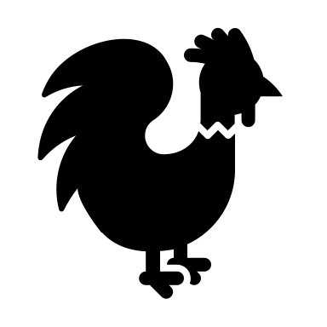
Ornithology
North Carolina coaches clinic 2019-2020
Taylor Knoll – taylorrknoll@gmail.com

Slide 2
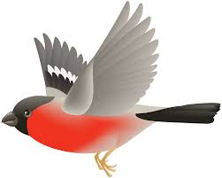
RULES
2 people compete together in this event
Competitors must be able to identify and answer questions about the listed orders, families, and species on the 2020 Ornithology list
Competitors must be able to answer general questions about birds
The 2020 list of specific species is provided with the rules
North Carolina has a MODIFIED list which can be found on the website
For some species, you must be able to identify their call… which will be played through a speaker most of the time
Allowed one binder no greater than 2 inches in ring diameter and one field guide that must be shared between partners
The binder may be filled with information from any source

Slide 3
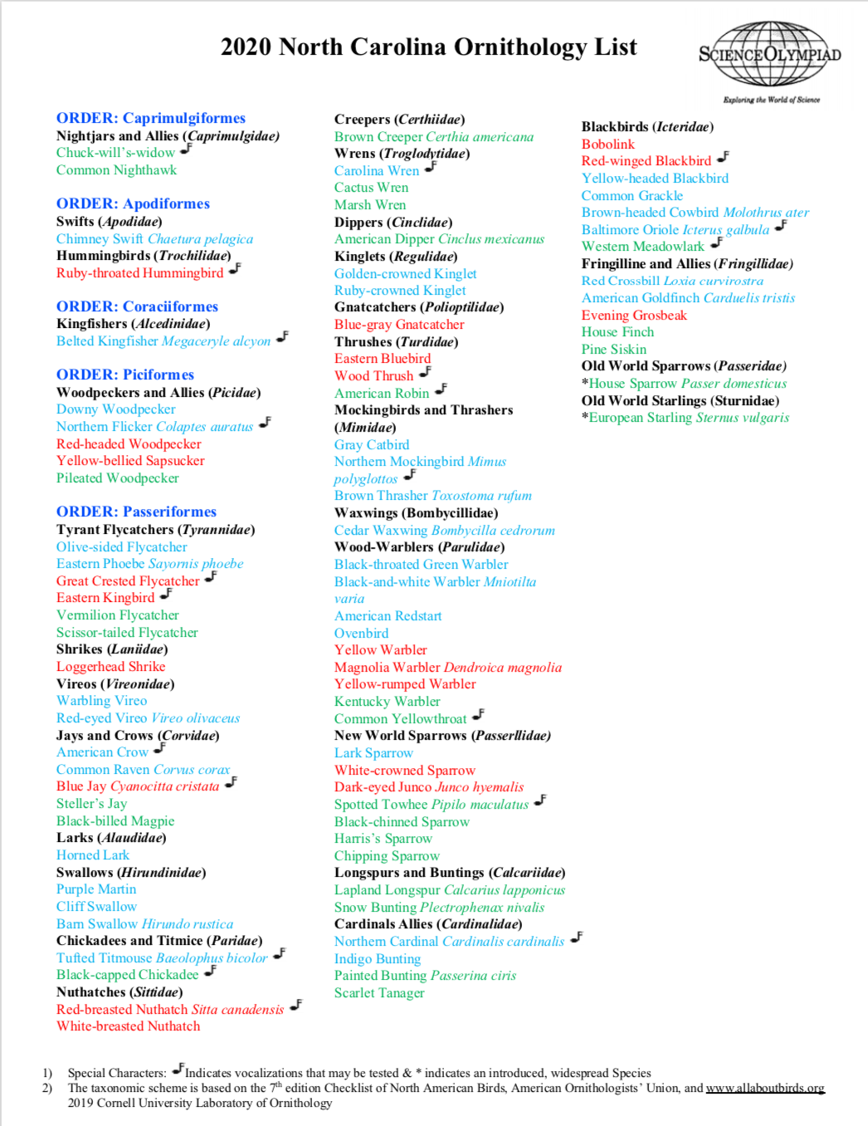

Slide 4
THE COMPETITION
Ornithology is a stations event
Competitors will need to answer a number of questions in a short amount of time and then move on to the next station
This can mean physically moving or a PowerPoint may switch slides

Slide 5
Example Station for the Regional/Division B level:

Slide 6
Example Station for the State level:

Slide 7
BINDER FORMATTING
TABS - have a binder tab for each Order
Alphabetize the species within each Order - makes it easier to find

Slide 8
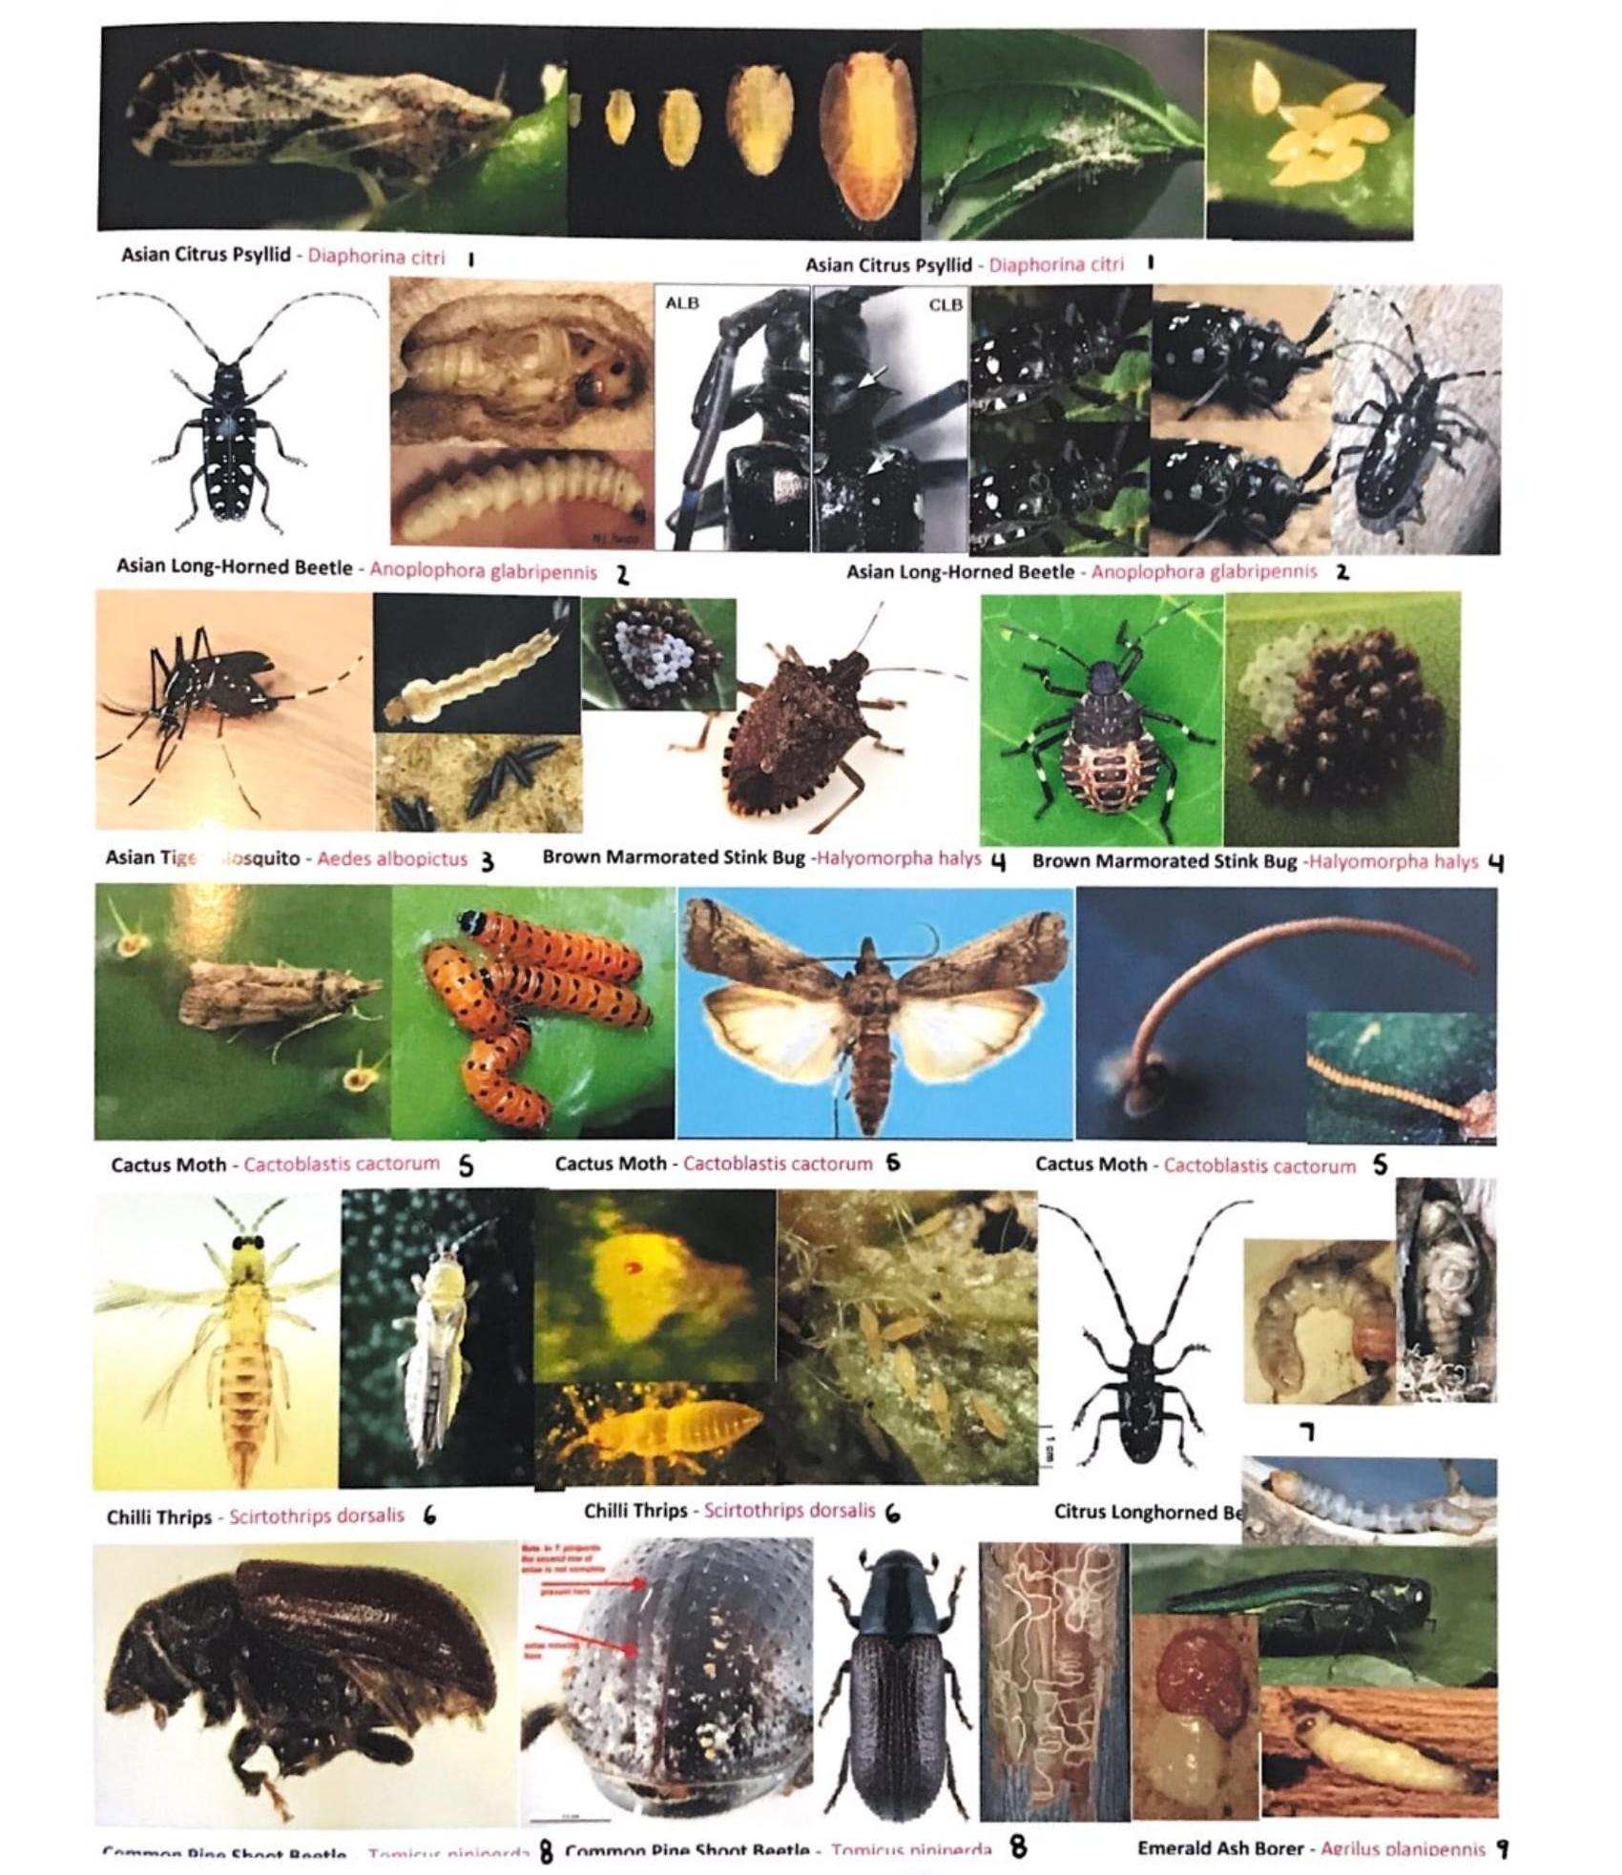
PICTURE FORMATTING
Put pictures in the front of the binder
To conserve space, put multiple pictures on a single page and label each image with its scientific and common name
Add page numbers that correspond with the fact sheet for that species

Slide 9
FACT SHEET FORMATTING
1 fact sheet per order/family/species that contains all of the characteristics listed in the rules (habitat, diet, conservation, etc.)
Create a generic table that includes all of the characteristics to use as a template for each fact sheet
Avoid paragraphs of text - be concise
Don’t be afraid to use small text to conserve space!!
Arial font and text size as small as 4
Include distribution maps for each species

Slide 10
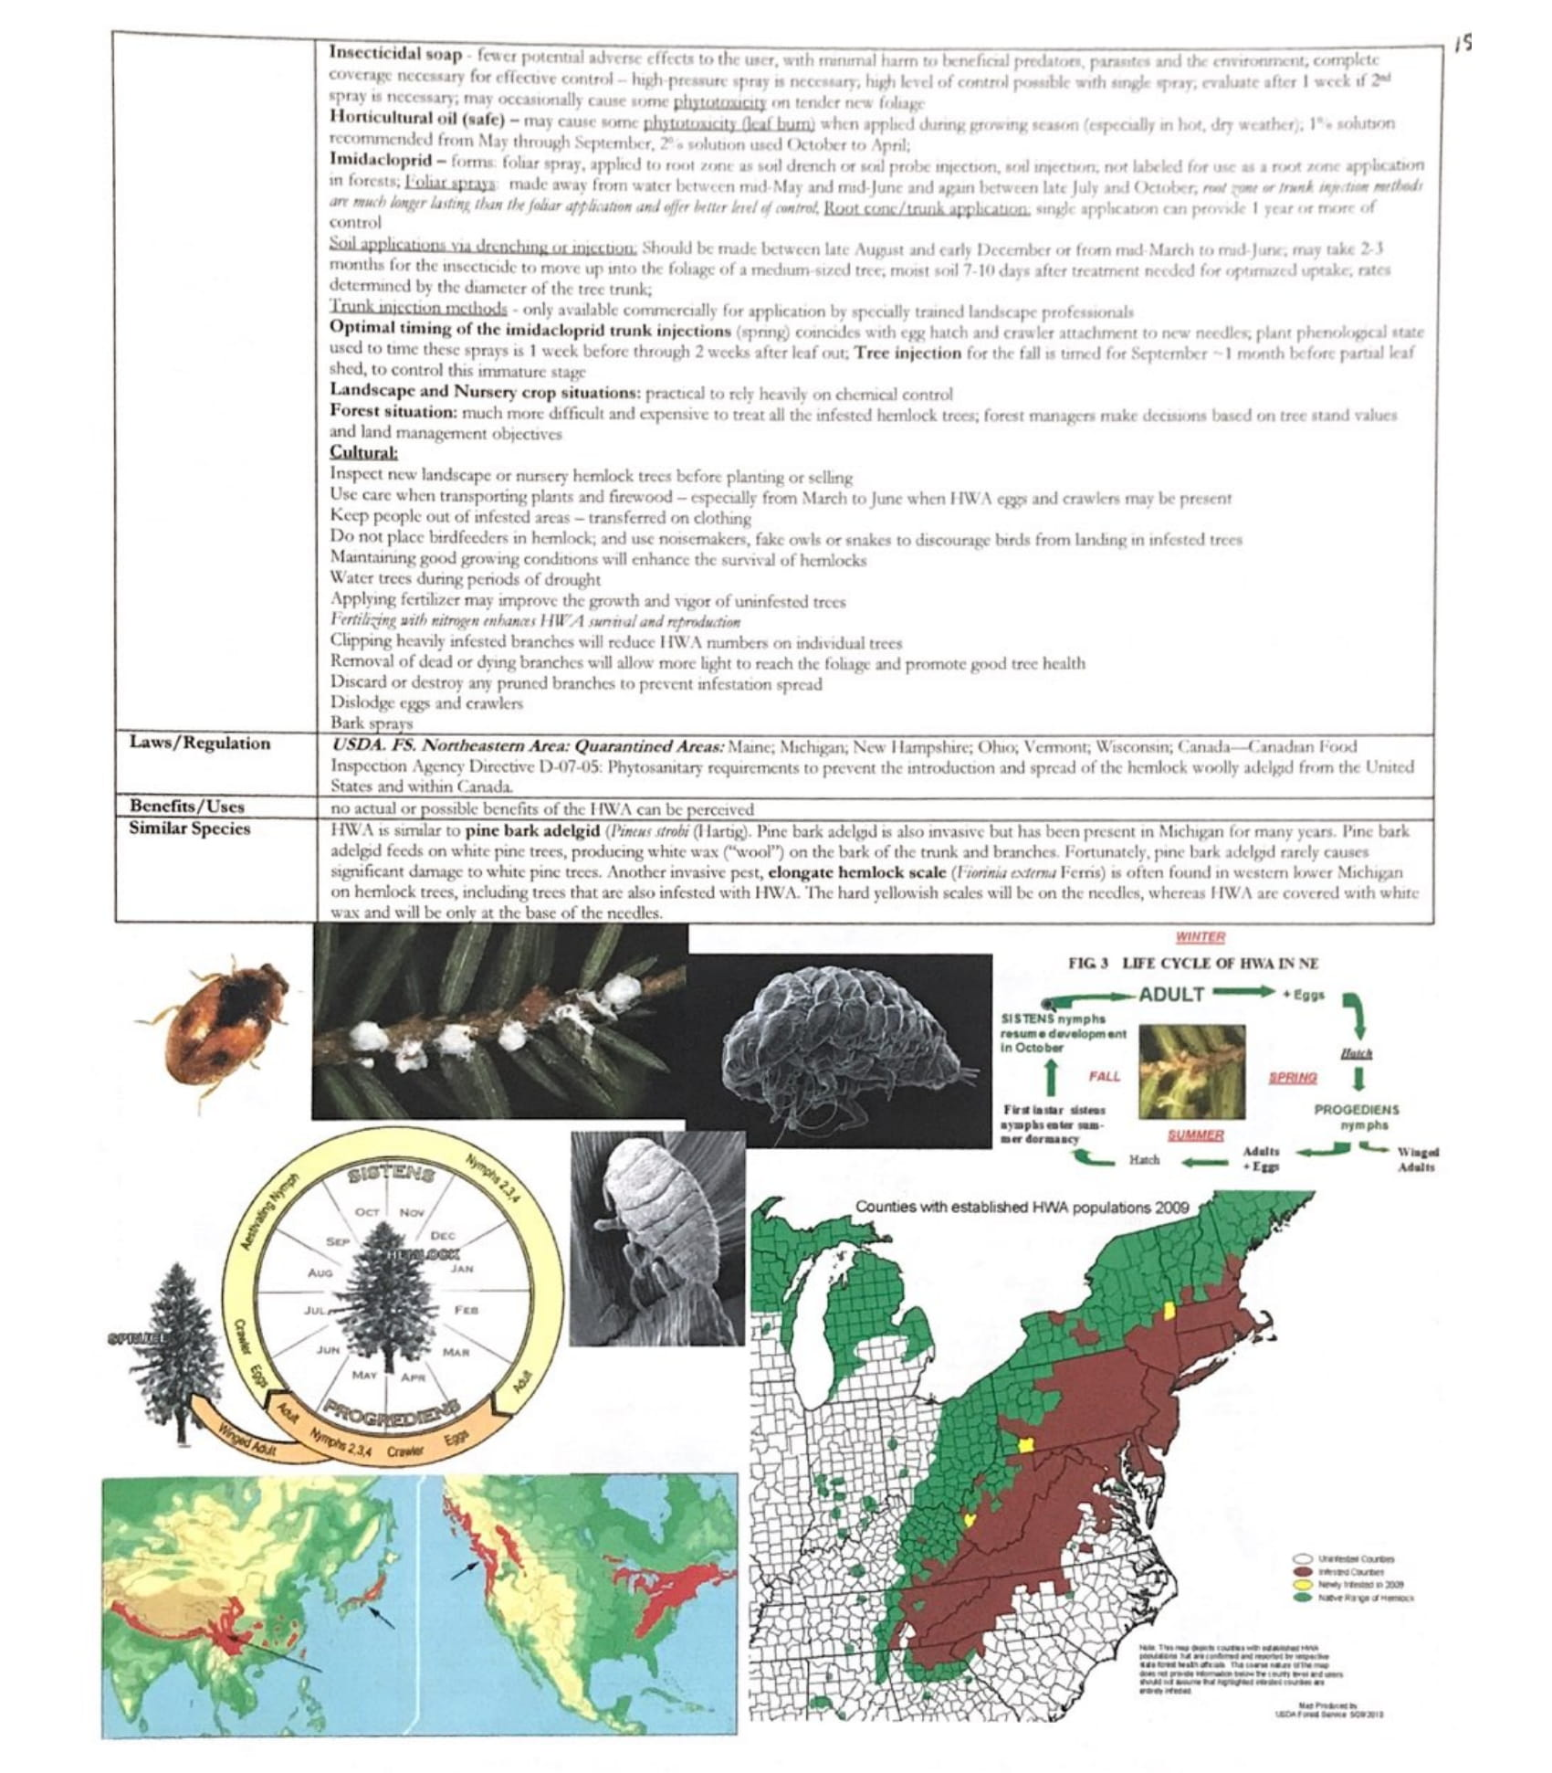

Slide 11
FACT SHEET FORMATTING CONT.
Make fact sheets for general information as well!
Create specific pages on general bird anatomy, respiration, history/evolution, etc.
Calls: write the calls out phonetically and keep a list of them on one page
EX: “cuckoo cuckoo” “caw caw”

Slide 12
TIPS FOR COMPETING
Partner communication is key!
Make a plan for who answers what question numbers ahead of time – don’t work on questions together if possible
Decide who will be the designated binder flipper
Speed is key!
It’s important you can identify the image right away, giving you as much time as possible to answer the questions
What happens when you can’t identify the species?
Look for clues in questions, look for general questions to answer first, and/or use your best guess… you always want to put something down
Both team members should memorize both the scientific and common names
Practice tests!!!
Create an audio of all the calls

Slide 13
RESOURCES
Cornell University
https://www.allaboutbirds.org/guide/search
https://www.birds.cornell.edu/home/
Wikipedia
Audubon
https://www.audubon.org/field-guide/bird/
Research papers
Search exactly what you are looking for!
For calls:
https://www.bird-sounds.net
https://abcbirds.org/blog/favorite-bird-sounds-songs-united-states
Youtube (Cornell Learn Bird Songs)

