Slide 1
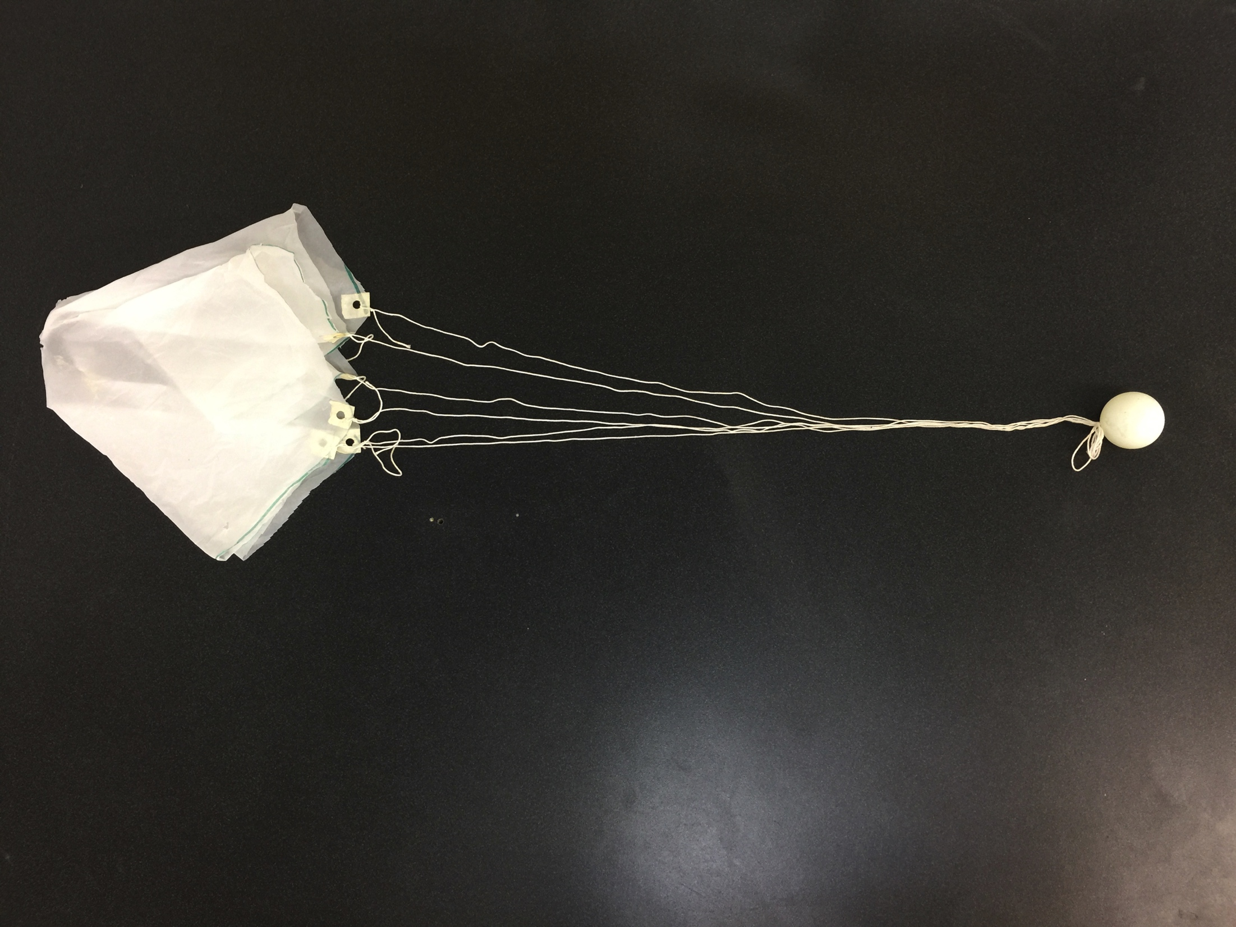
Parachutes
Part 1 How to make parachutes of two different designs.
Notes:
This lesson consists of several parts. 1. How to make a parachute of different designs. 2. How to test parachutes. 3. The Physics of parachutes 4. Ping Pong Parachute Student Research. 5. PPP as it relates to NC science objectives.

Slide 2
Parts of a Parachute
Canopy
Shroud Lines
Ball of Ping
aka. The Payload

Slide 3
Making a Parachute Materials Needed
Plastic Bags (1 / group of 2 students. Ultra thin dry cleaning bags work great!)
Masking Tape (1 foot per group of 2 students)
Thin yarn (kite string or thinner) (Students remove needed lengths from string supply located on ring stand. (Shown in later slide)
Ping Pong Ball (1 per parachute made. Usually 2 per group of 2 students.)
Meter Stick (One per group of 2 students.)
Ruler (One per group of 2 students.)
Razor Blade ( The Teacher is the only one who uses it.) Scissors 1 pair per group

Slide 4
Making a Parachute Materials Needed

Slide 5
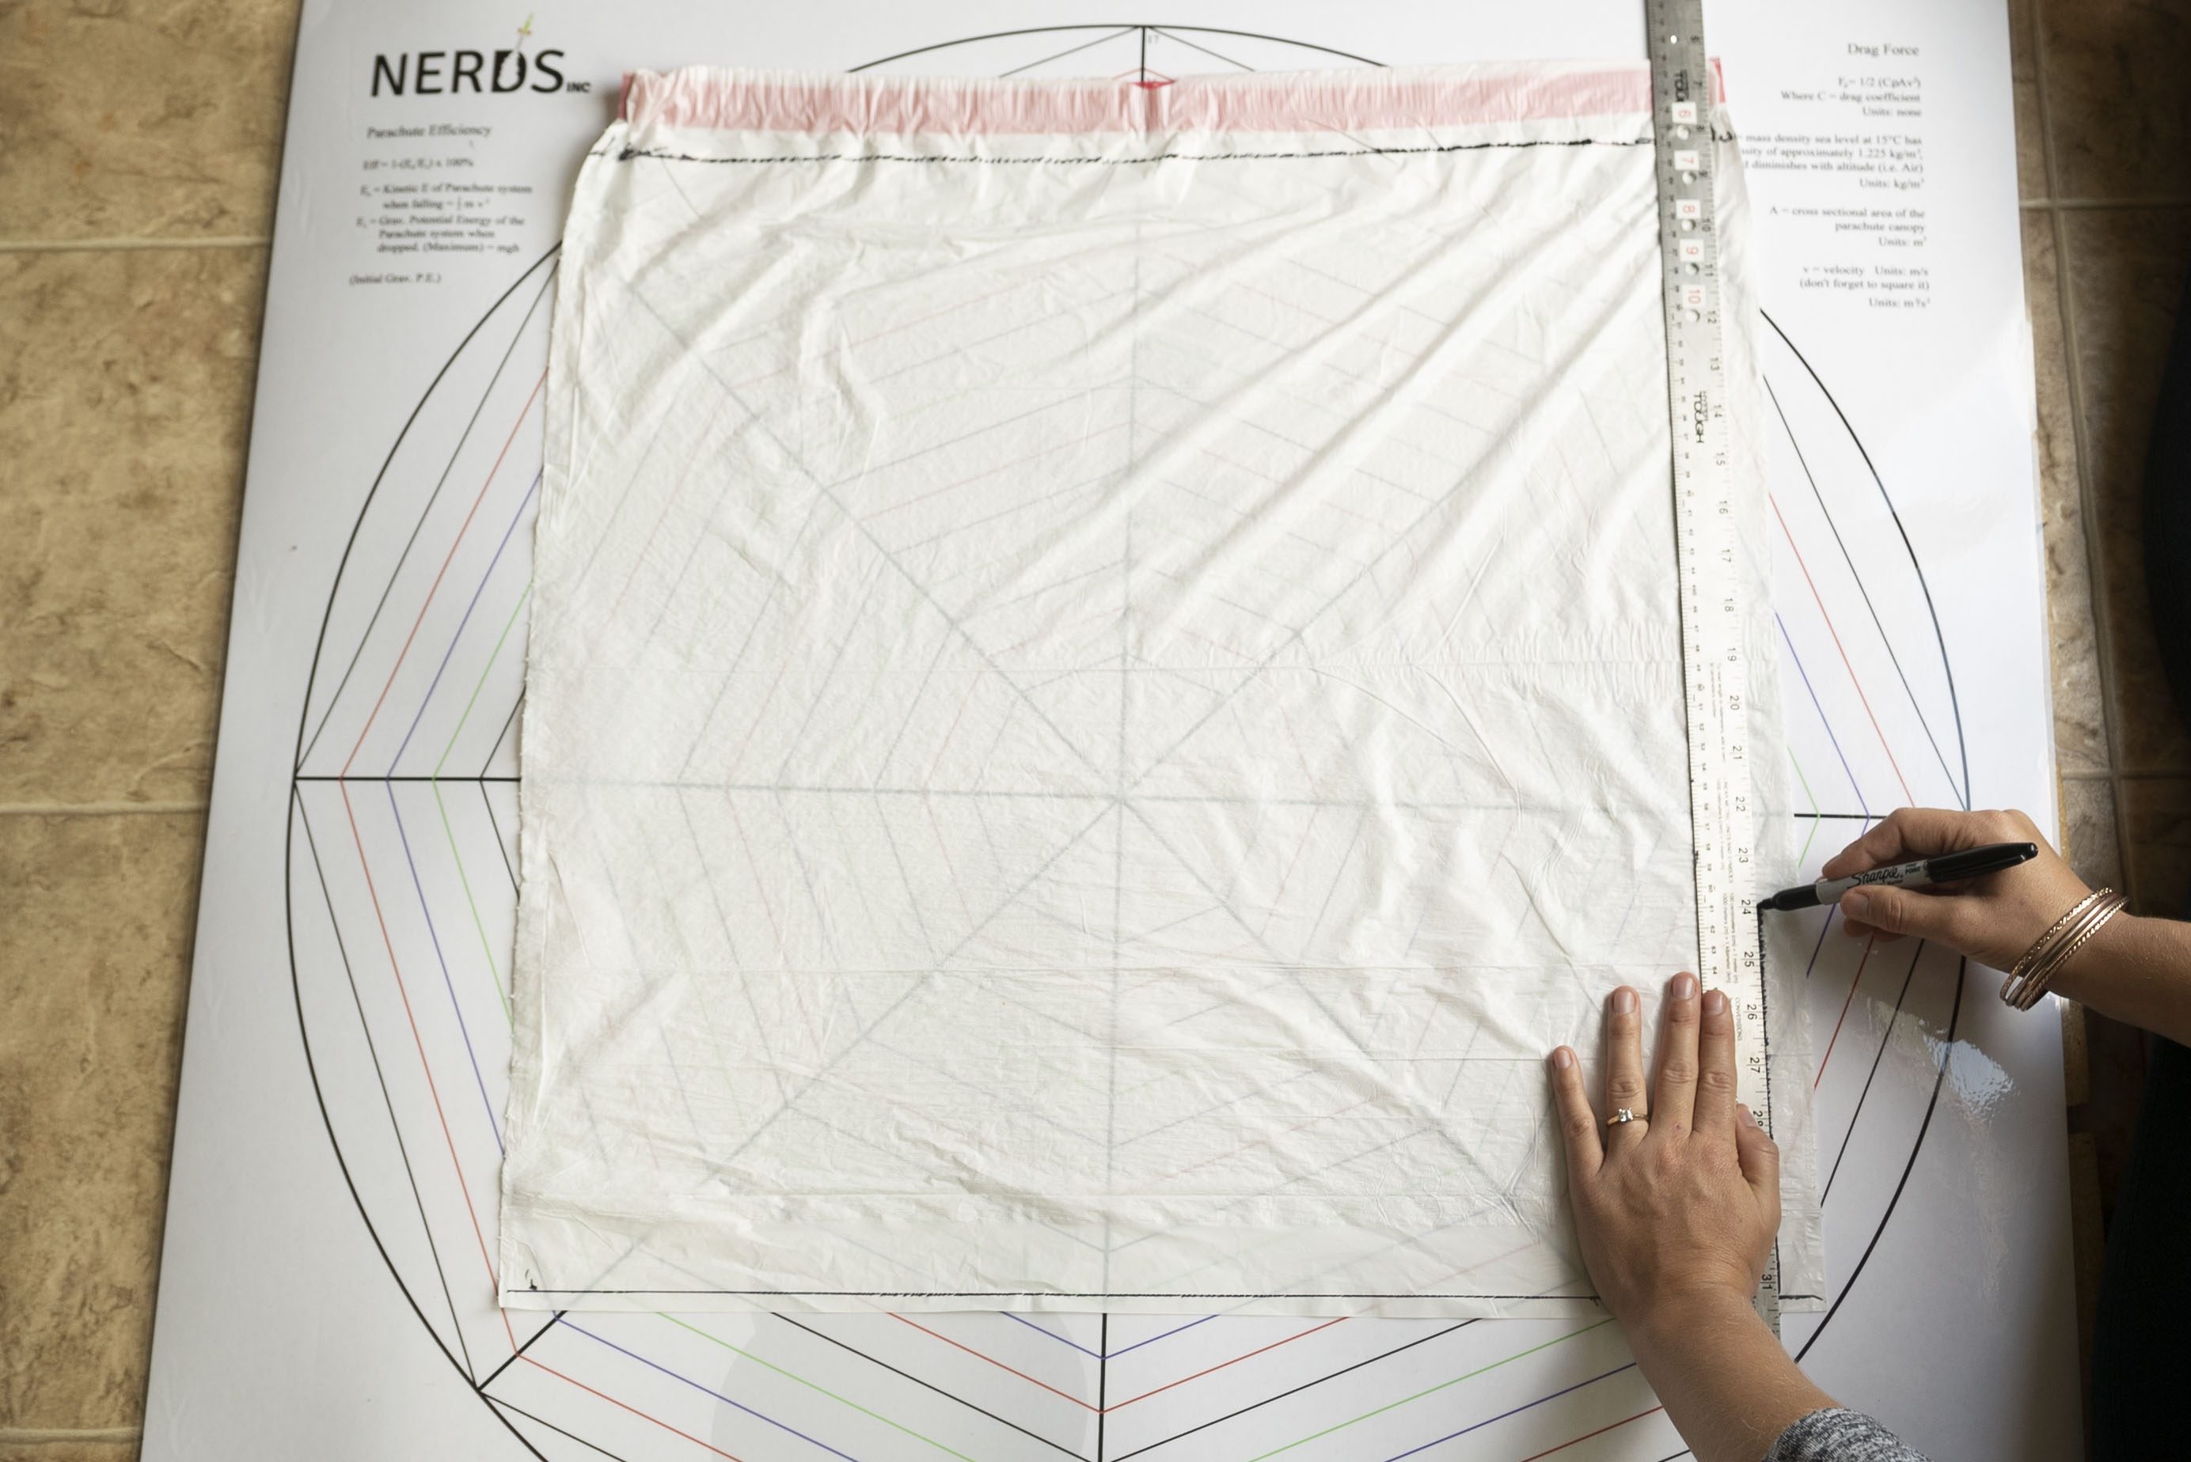
Making a Parachute Marking the Dry Cleaning Bag
Using a marker and a meter stick draw lines on the bag. Make a symmetrical shape (a square works nicely)

Slide 6
Making a Parachute Cut out the square

Slide 7
Making a Parachute Now you have two canopies.

Slide 8
Making a Parachute Put the canopy on the Parachute Template as shown.

Slide 9
Making a Parachute Tape the canopy to the Template.

Slide 10
Making a Parachute The canopy is taped to the template.

Slide 11
Making a Parachute Use the Parachute Template to Trace lines on the canopy (Tracing along line 6 makes a 12 inch hexagonal shaped canopy.) Use the Parachute Template to draw all of the straight lines on the canopy as well.
Notes:
Don’t forget to use the Parachute Canopy to draw in all of the straight lines!

Slide 12
Making a Parachute Cut out the octagonal parachute canopy

Slide 13
Making a Parachute Shroud line length ≥1 diameter The octagonal canopy has eight sides so 4 strings will be made. Each string is two shroud lines, so each string goes to the next adjacent side. This canopy is 12 inches across so we make 4 strings-36 inches long.
Notes:
All Shroud Lines do not need to be the exact same length.

Slide 14
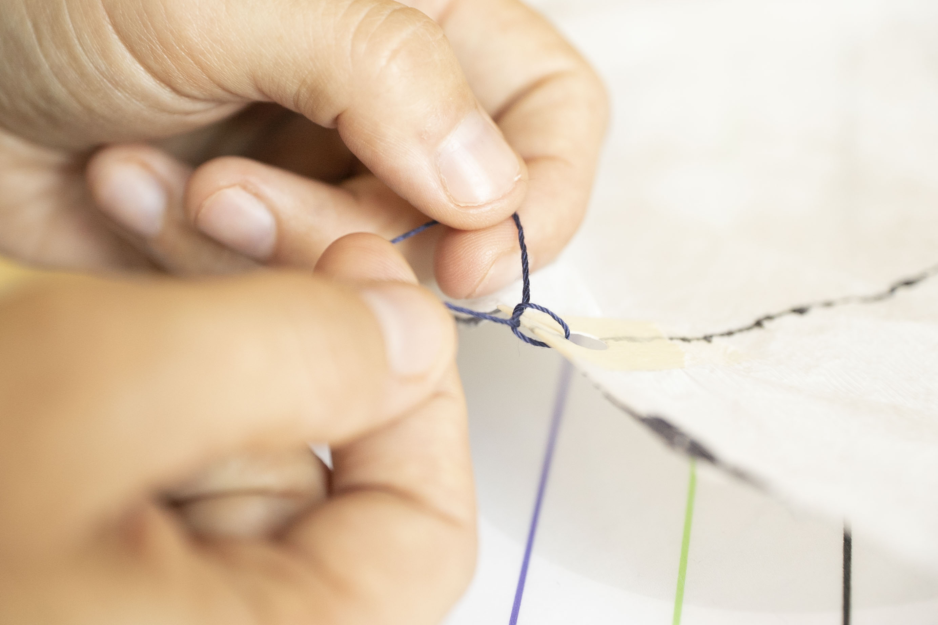
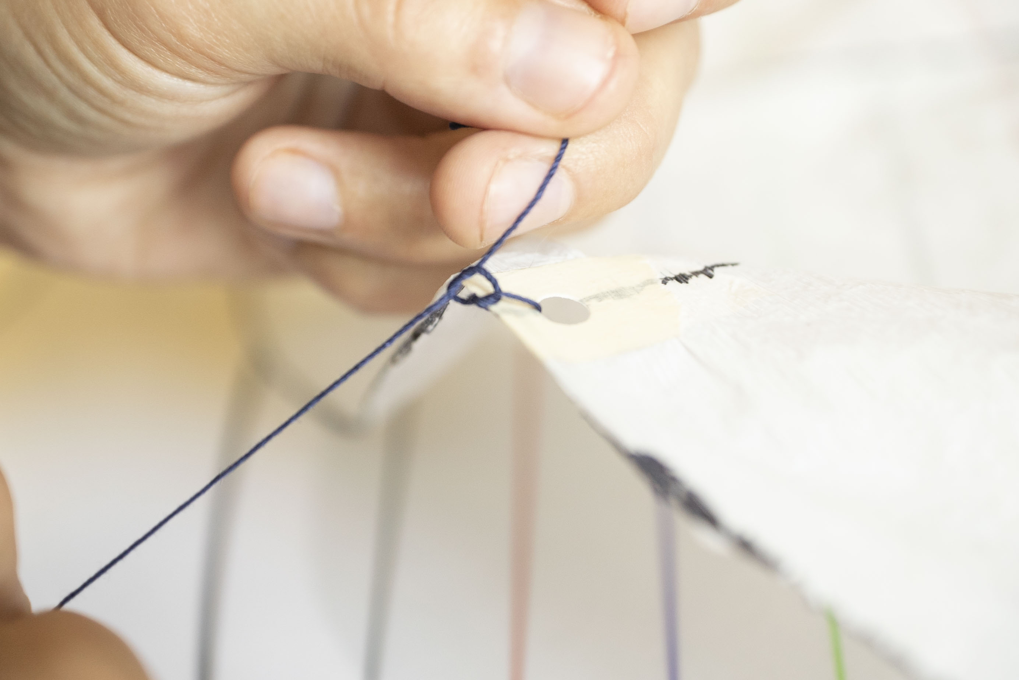
Making a Parachute Tying the strings to the canopy

Slide 15
Making a Parachute Tie the 4 strings.

Slide 16
Making a Parachute Insure that all Shroud Lines are the same length. Fold the Canopy in halves until all of the attachment points line up.

Slide 17
Making a Parachute While your partner holds the tip of the canopy pull on the shroud lines and tie a knot. The S.L.s lengths are limited to the shortest line.

Slide 18
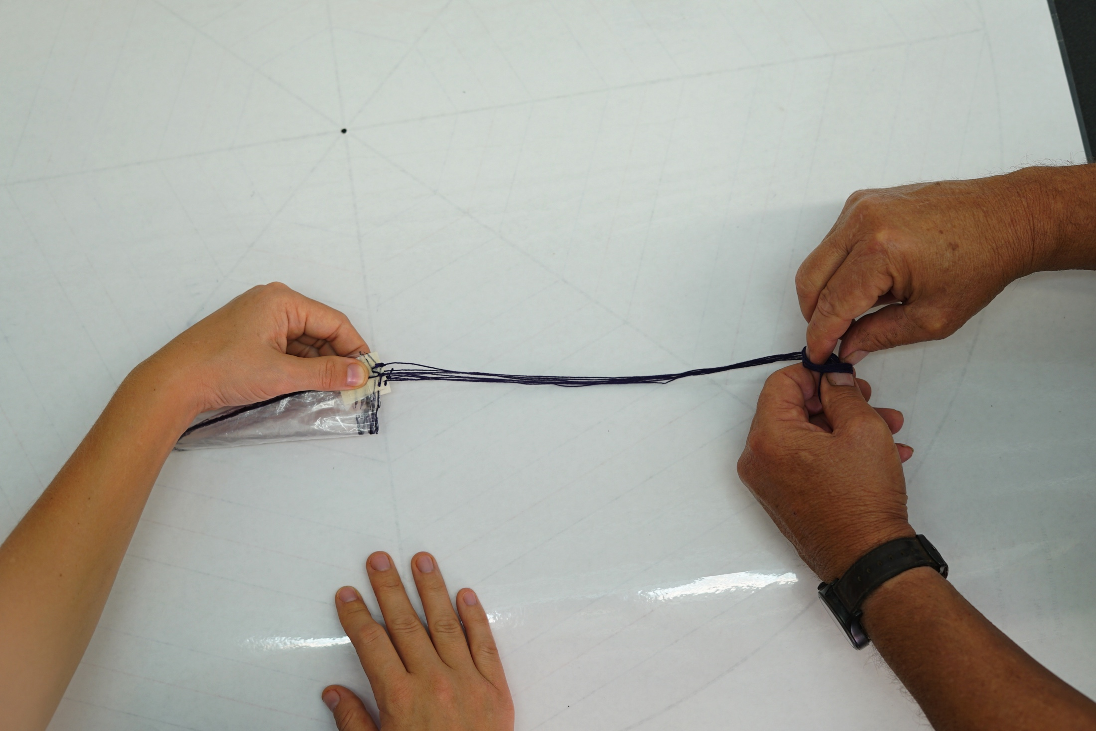
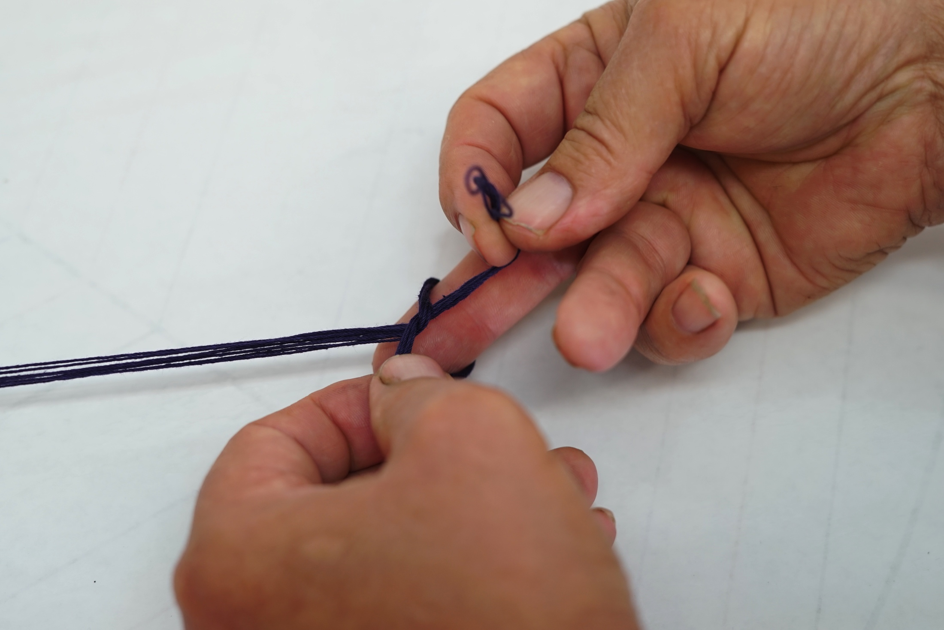
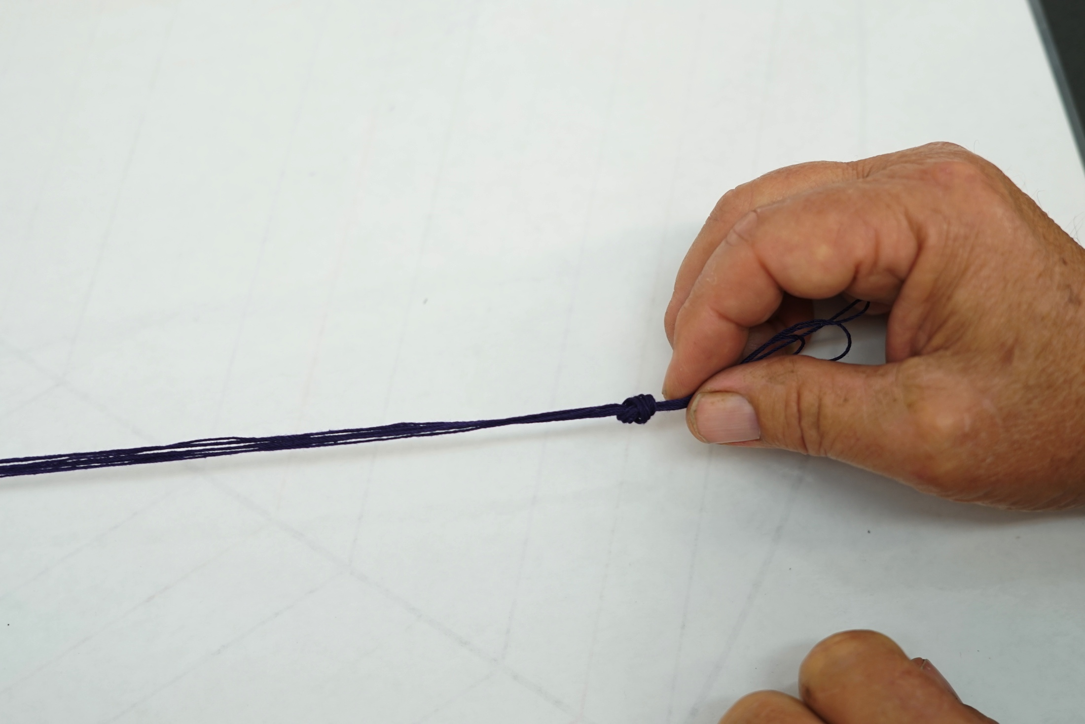
Making the Parachute Tie the knot

Slide 19
Making a Parachute Tape the PP Ball to the Shroud Lines

Slide 20
Making a Parachute A finished octagonal Parachute. Ready for testing

Slide 21
Making a Parachute The Second Parachute Canopy Design
Repeat every step as before up to taping the canopy to the template.

Slide 22
Making a parachute Drill holes in a Meter Stick in the following locations. Feel free to drill holes beyond those shown. ( a 12 inch ruler is great for smaller parachutes.)

Slide 23
Making a Parachute Here is a close up of hole location. The numbers represent the radius of the circular canopy.

Slide 24
Making a Parachute Attach the canopy to the Parachute Template as shown.

Slide 25
Making a Parachute Beginning the Circular Canopy Design Make a hole in the center of the template
Notes:
Use a sink cut out or a scrap piece of wood so desks aren’t damaged.

Slide 26
Making a Parachute Drill a guide hole for the nail. Hammer a nail as shown.

Slide 27
Making a Parachute Use your meter stick or ruler as you would a compass to make a circle. Here we’re making a 10 inch radius (20 inch diameter) circular canopy.
Notes:
Note: This is too big for a Ping Pong Ball.

Slide 28
Making a Parachute Here is the drawn 20 inch diameter circular canopy.

Slide 29
Making a Parachute Use the Parachute Template to draw in the straight lines as shown.

Slide 30
Making a Parachute Cut out the circular canopy

Slide 31
Making a Parachute Attaching the Shroud Lines. Put tape at each of the corners. (Where the straight lines reach the edge of the canopy.)

Slide 32
Making a Parachute Fold the tape over so it is on both sides of the canopy.

Slide 33
Making a Parachute Punch holes through the masking tape. Use a hole punch or a pencil or any pointed object.

Slide 34
Making a Parachute Here’s the hole through the masking tape. Repeat this for each of the corners.

Slide 35
Making a Parachute Shroud Line Length S.L.Length≥Canopy Diameter

Slide 36
Making a Parachute For our 20 inch circular parachute if we wanted S.L.L. to be 1.5 the diameter we need 30 inch shroud lines

Slide 37
Making a Parachute Our 20 inch diameter canopy needs 8 shroud lines of 30 inches in length.

Slide 38
Making a Parachute Tying the strings to the canopy

Slide 39
Making a Parachute The intersection of the straight line with the edge of the canopy has shroud lines tied to it.

Slide 40
Making a Parachute The Circular Chute is ready for testing!

