Slide 1
Greensboro Science Olympiad Coaches Meeting - Feb. 3, 2024
AGENDA
Greetings
Registration/Forms/Policies
Event Locations and Travel To Them
Event Information
Award Ceremony
Emergency Procedures
Improvement of Greensboro Tournament

Slide 2
Thank you for coming and for your support for Science Olympiad!

Slide 3
Registration
Currently: 26 B Division Teams
33 C Division Teams
Check In As Needed: Room 112 Sullivan
Turn in Photo Consent Forms
Pick up wrist bands
Pick up Kaplan STAR wrist bands
Pick up garbage bags

Slide 4
Home Bases
See list
Note: Sullivan, Moore, and Nursing & Instructional Bldg will be used.
Tentative assignments
Please clean up your space at the end of the day.
(There are dumpster behind Sullivan (east side))

Slide 5
Schedules

Slide 6
Do you have things to share?
For others and especially for new coaches and teams:
How to prepare-
Transportation-
Surviving the day-
Support from parents, teachers, principals, etc

Slide 7
Safety
Students will not be allowed to compete if they do not have the proper safety equipment and use it (safety goggles, lab coats, etc)

Slide 8
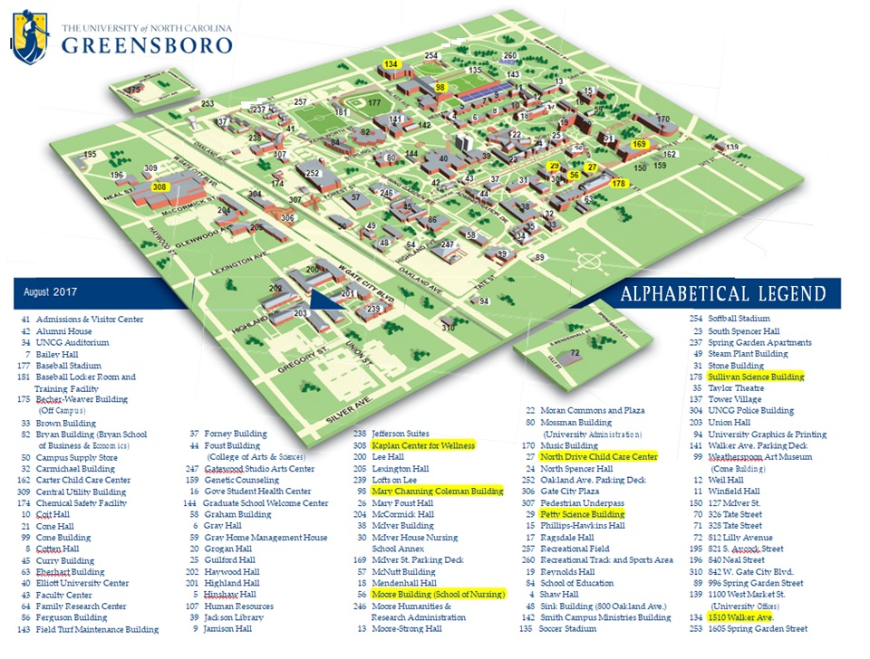

Slide 9
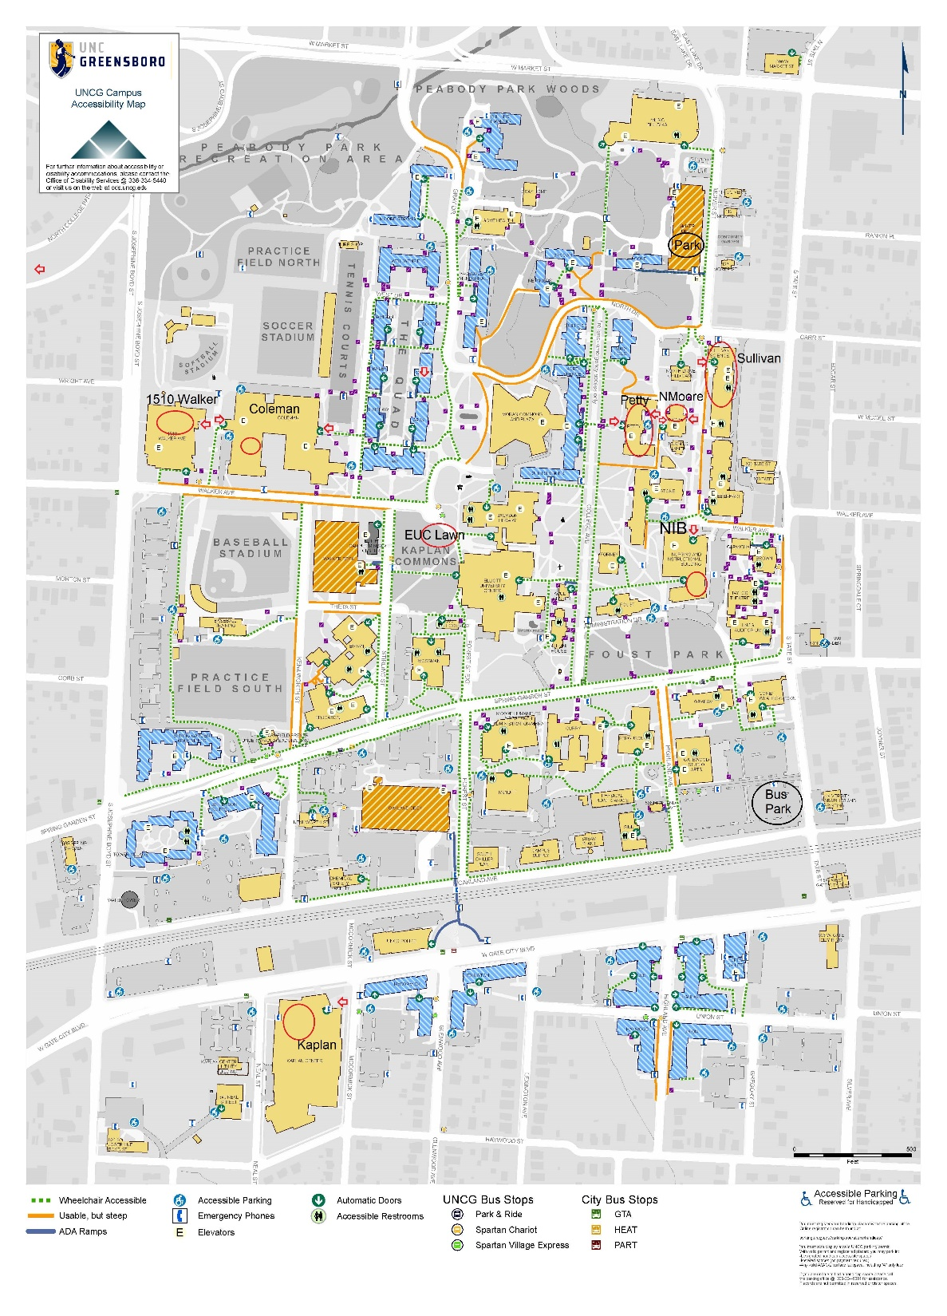

Slide 11
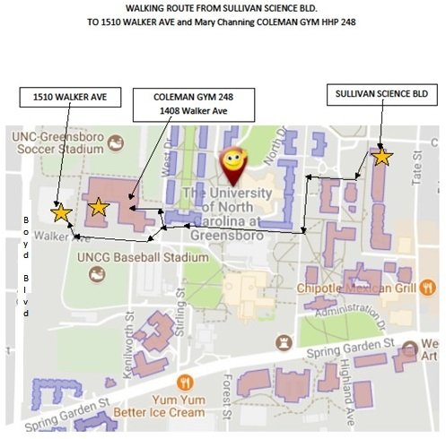
Library
(White Tower)
Return

Slide 12
1510 Walker Entrance
PARKING AVAILABLE IN THE LOT WITH ENTRANCE AT “X”
Use O entrances

Slide 13
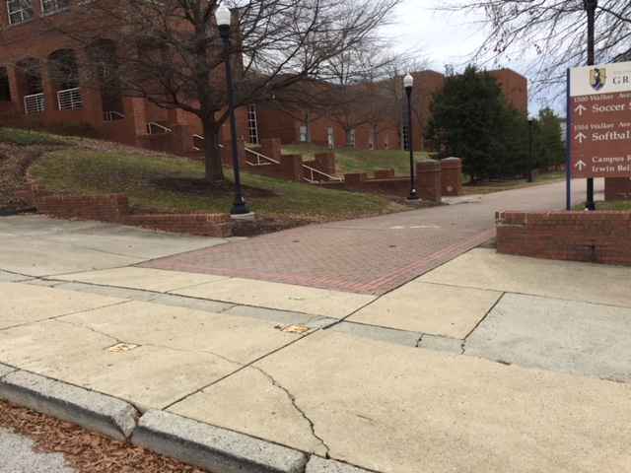
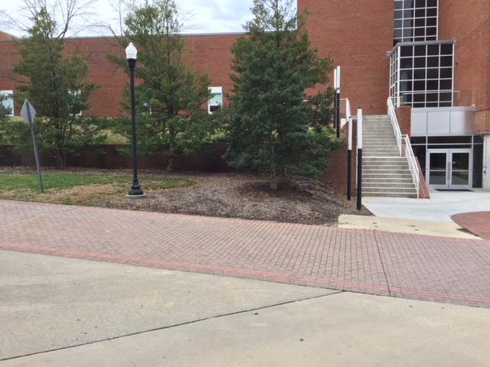
1510 Walker Avenue Bldg
Approach from Walker Ave Entrance

Slide 14
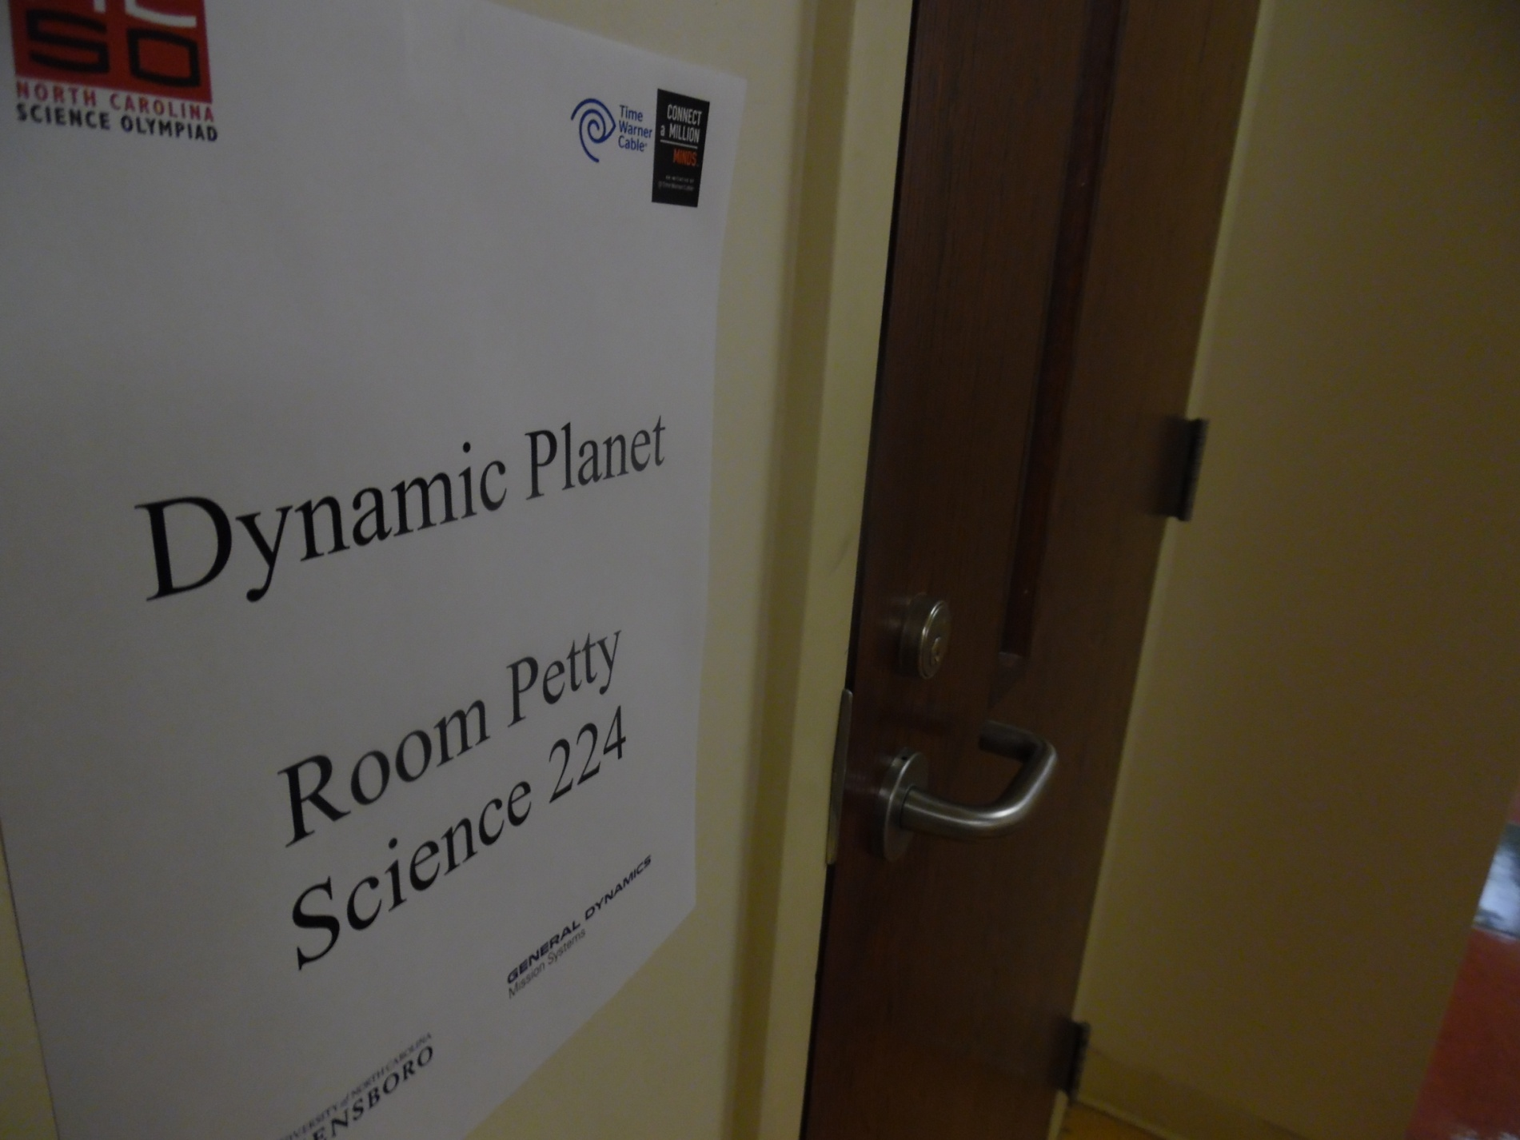
All event rooms will have signage similar to this posted at the door

Slide 15
Impounds
Occurs at the front end of the session. Event leaders who lead events that are on the far side of campus tend to be lenient on impound deadline, but please try to meet the deadline
See the schedule
Once impounded, the only allowed modification time is as specified for the competition window

Slide 16
Flight
Return
Return

Slide 17
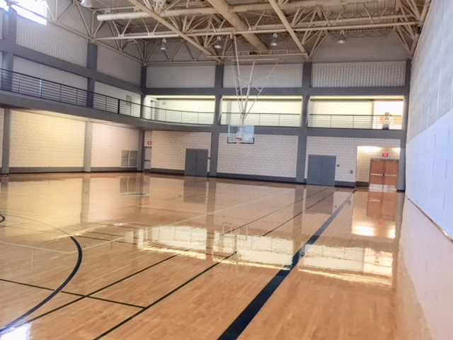
Trajectory, Storm the Castle, Wheeled Vehicle and Scrambler surface:
Gym Floor in 1510 Walker Ave Building
Return

Slide 18
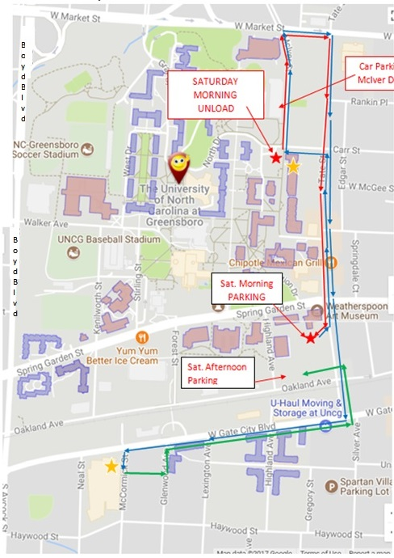
BUS DRIVING/PARKING INSTRUCTIONS - 2024
Science Olympiad activities are held in the Sullivan Science
The entrance is on Carr St & is marked with a gold star
Please refer to the accompanying maps.
Detailed driving directions may be obtained from http://www.uncg.edu/online-map/ by clicking on "Spartan Directions >" then indicating from where you are coming and select your destination as North Drive Child Care Center.
SATURDAY morning:
To unload students, buses are to come to the parking lot of the North Drive Child Care Center. This is building number 27 marked by the red star on the campus map. North Drive and Carr St. are the same road.
The following directions are meant to avoid a very sharp right hand turn from Carr St. onto Tate St. After unloading, buses are to follow the red arrows to the parking lot behind the Weatherspoon Art Museum This lot is marked by a red star. In other words go north on McIver St., right onto Market, right onto Tate, cross Spring Garden and turn right into the lot behind the Art Museum. Please do not park in spaces reserved for the Weatherspoon Art Museum.
SATURDAY Afternoon:
To pick up students and transport them to the Awards Ceremony, go back to the Sullivan Bldg, (the blue arrows on the map) leave the parking lot behind the Art Museum by turning left onto Tate St., turn left onto Carr St. and load up at the end of the Sullivan Bld..
The Awards Ceremonies are in the Kaplan Recreation Center. To get there turn right onto McIver St., (blue arrows) right onto Market St., right onto Tate St., right onto W. Gate City Blvd, and left onto McCormick St and unload at the gold star on the driving maps.
After unloading, follow the green arrows on Bus Driving-ParkingMap_ to return to the lot off Tate St. by turning left into lot #49, left onto Glenwood Ave., right onto Gate City Blvd., left onto Tate, and left into lot #7 South. Then drive as far from Tate St. as you can if you want to walk back to the Awards Ceremonies.
To pick up students after the award ceremony, follow the blue arrows back to the entrance of the Kaplan Center for Wellness.
OR PARK IN LOT #50. SEE CAR MAP

Slide 19
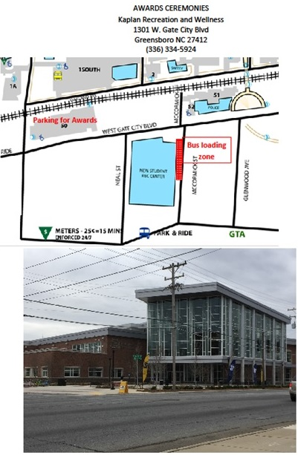

Slide 20
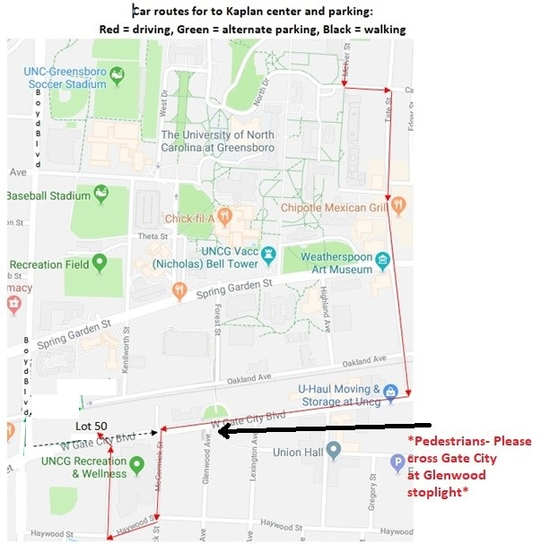
SAFETY FIRST!!
*PLEASE have everyone cross Gate City BLVD at the Glenwood intersection.
Campus police will be monitoring this intersection*

Slide 21
Walk to Kaplan

Slide 22
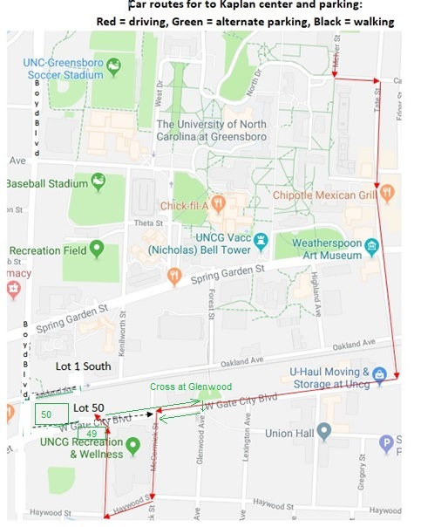
Cars To Kaplan
Buses can also
park in Lot #50

Slide 23
Awards Ceremony in Kaplan
Coaches, please get STAR wristbands for students and their guests at the Registration Room 112 SULV. The wrist bands will help the Kaplan staff identify who is attending for the Science Olympiad Awards Ceremony.
**VISITORS TO KAPLAN CANNOT USE THE EQUIPMENT****
Science Olympiad visitors should go from entrance to 3-court gym only

Slide 24
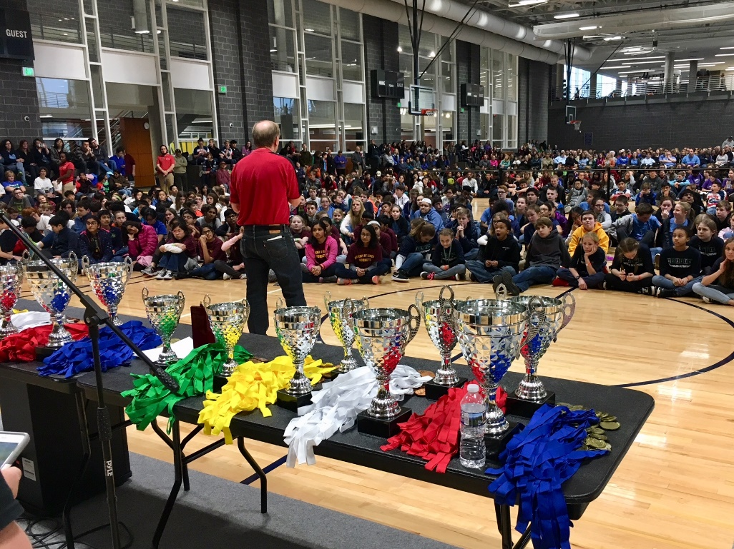
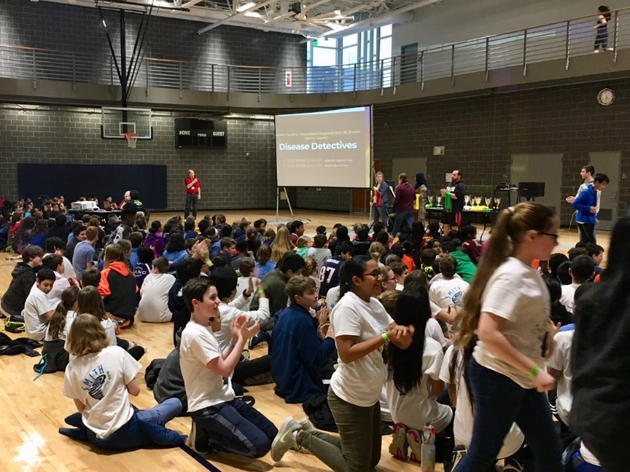
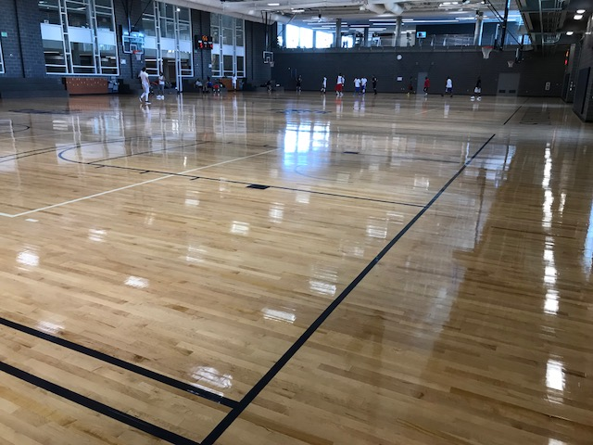
This is where we plan to hold the Awards Ceremonies.
There will be some chairs, but the students will be expected to sit on the floor.

Slide 25
Contact on Competition Day
All event leaders will have phone number for Jerry, PK, and Becky
One or two state North Carolina Science Olympiad staff may be on hand
Find a volunteer with an NCSO lanyard

Slide 26
Emergency Information
In case of an accident or extreme health concern, call 336-334-4444 or 911 or
find a red phone and simply lift it to make the call.

Slide 27
Improvement of Greensboro Tournament
What would you like to see added or changed?
What should we do to recruit more schools?
Can C Division make suggestions for B Division?

Slide 28
THANK YOU AGAIN
FOR ALL THAT YOU DO!

Slide 30
